Slide 1
Netfilter를 이용한 packet capturing

Slide 2
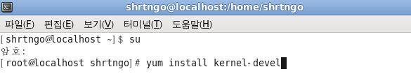
Setting testing environment
Download and setup linux kernel

Slide 3
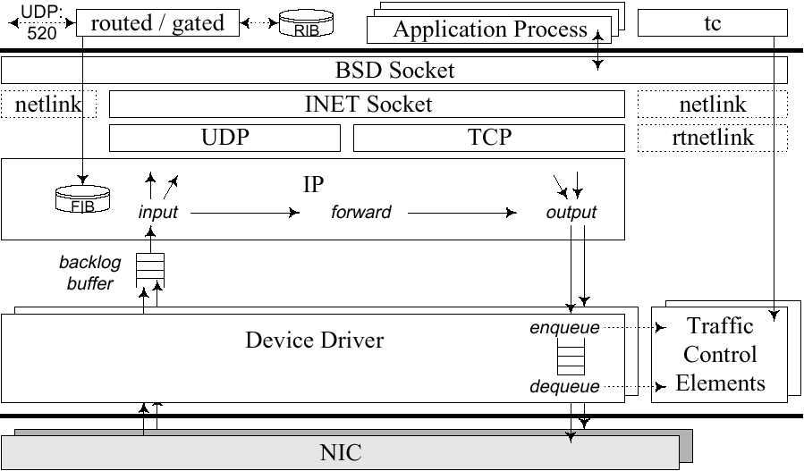
Network device driver

Slide 4
Internet protocol in Linux
Higher Layers
ip_input.c
ip_output.c
ip_queue_xmit
ip_local_deliver
IP_LOCAL_OUTPUT
IP_LOCAL_INPUT
ip_queue_xmit2
ip_forward.c
IP_FORWARD
ip_local_deliver
ip_forward
ip_forward_finish
ip_output
ip_rcv_finish
ip_fragment
ip_finish_output
IP_PRE_ROUTING
IP_POST_ROUTING
ip_rcv
ip_finish_output2
dev.c
dev.c
net_rx_action
dev_queue_xmit

Slide 5
Socket buffer
skb (Linux Socket buffer)‏
Buffers in which linux kernel handles network packets
Packet is received by network card, put into a skbuff and then passed to the network stack
Packet data and management information
The sk_buff is first incomplete, then filled in during passage through the kernel, both for received packets and for sent packets
커널 내의 다양한 네트워크 계층을 지나감에 따라 완성되는 패킷 구조체

Slide 6
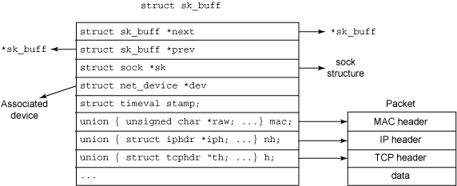
sk_buff structure

Slide 7
Review of network device driver & packet capturing
Capture the packet!!

Slide 8
Makefile
obj-m := drop.o
all:
make -C /lib/modules/$(shell uname -r)/build M=$(PWD) modules

Slide 9
drop.c
#include <linux/module.h>
#include <linux/skbuff.h>
#include <linux/netdevice.h>
#include <linux/netfilter.h>
#include <linux/netfilter_ipv4.h>
#include <linux/in.h>
#include <linux/tcp.h>
#include <linux/udp.h>
#include <linux/ip.h>
static struct nf_hook_ops netfilter_ops;
struct sk_buff *sock_buff;
unsigned long inet_aton(const char*);

Slide 10
drop.c
unsigned int main_hook(unsigned int hooknum, struct sk_buff *skb,
const struct net_device *in,
const struct net_device *out,
int (*okfn)(struct sk_buff*))
{
struct iphdr *iph = ip_hdr(skb);
unsigned long saddr = 0, daddr = 0;
unsigned short sport = 0, dport = 0;
struct tcphdr *tcph = (struct tcphdr*)tcp_hdr(skb);
unsigned long cse = inet_aton("164.125.7.52");
saddr = iph->saddr;
daddr = iph->daddr;
if(saddr == cse){return NF_DROP;}
return NF_ACCEPT;
}

Slide 11
drop.c
int init_module()
{
netfilter_ops.hook = main_hook;
netfilter_ops.pf = PF_INET;
netfilter_ops.hooknum = NF_INET_PRE_ROUTING;
netfilter_ops.priority = 1;
nf_register_hook(&netfilter_ops);
return 0;
}
void cleanup_module()
{
nf_unregister_hook(&netfilter_ops);
}

Slide 12
drop.c
unsigned long inet_aton(const char * str)
{
unsigned long result = 0;
unsigned int iaddr[4] = {0,};
unsigned char addr[4] = {0,};
int i;
sscanf(str,"%d.%d.%d.%d ",iaddr,iaddr+1,iaddr+2,iaddr+3);
for(i = 0 ; i < 4 ; i++)
addr[i] = (char)iaddr[i];
for(i = 3 ; i > 0 ; i--)
{
result |= addr[i];
result <<= 8;
}
result |= addr[0];
return result;
}

Slide 13
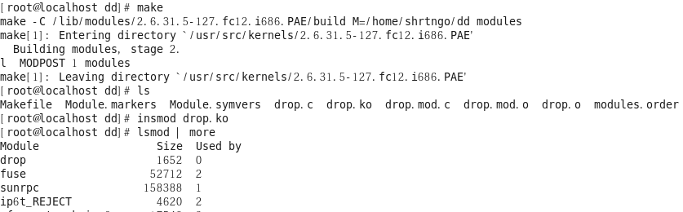
Compile & insert module

Slide 14
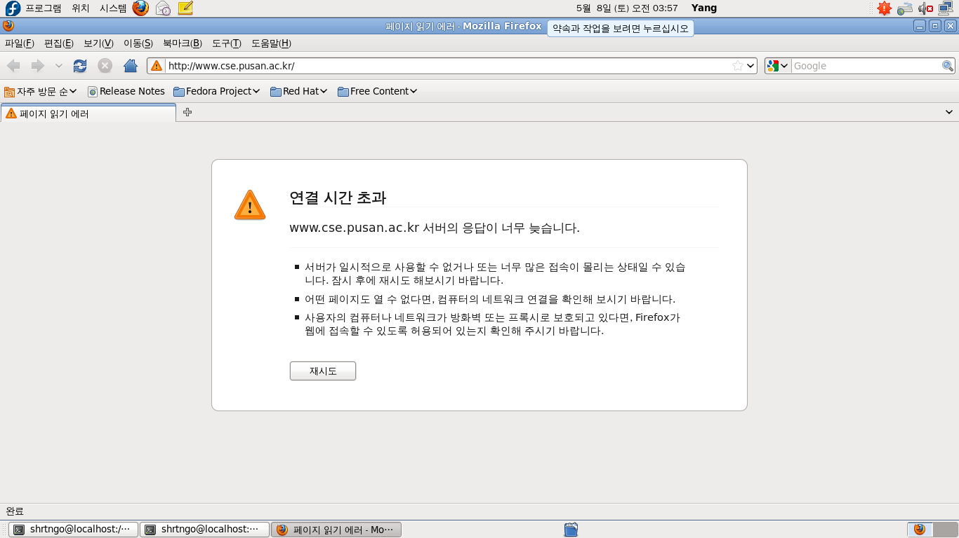
Test your simple firewall!

Slide 15
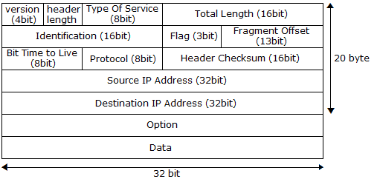
IP header

Slide 16
iphdr structure
/linux/ip.h
struct iphdr {
…
__u32 saddr;
__u32 daddr;
};

Slide 17
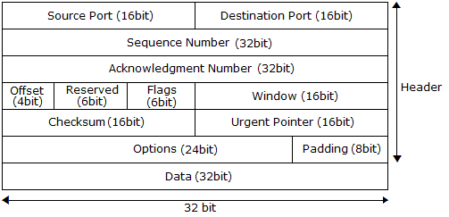
TCP header

Slide 18
tcphdr structure
/linux/tcphdr
struct tcphdr {
unsigned short source;
unsigned short dest;
...
};

Slide 19
Homework
방화벽 다시 만들어 보기
포트 체크 기능 추가 – FTP/SSH 포트 막아보기

